Slide 1
Graphs
Thanks to David Kauchak

Slide 2
Bridges of Konigsberg
The city of Königsberg in Prussia (now Kaliningrad, Russia) was set on both sides of the Pregel River, and included two large islands which were connected to each other and the mainland by seven bridges. The problem was to devise a walk through the city that would cross each bridge once and only once, with the provisos that: the islands could only be reached by the bridges and every bridge once accessed must be crossed to its other end. The starting and ending points of the walk need not be the same.

Slide 3
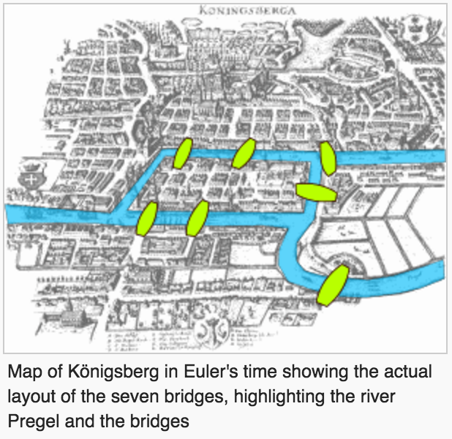
Bridges

Slide 4
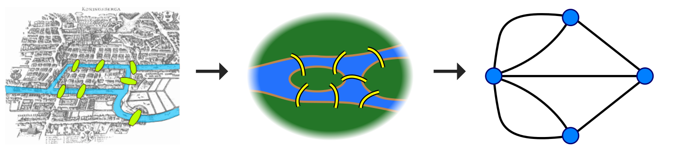
Bridges to Graphs

Slide 5
Graphs
What is a graph?
A
B
F
D
E
C
G

Slide 6
Graphs
A graph is a set of vertices V and a set of edges (u,v) ∈ E where u,v ∈ V
A
B
F
D
E
C
G

Slide 7
Graphs
How do graphs differ? What are graph characteristics we might care about?
A
B
F
D
E
C
G

Slide 8
Different types of graphs
Undirected – edges do not have a direction
A
B
F
D
E
C
G

Slide 9
Different types of graphs
Directed – edges do have a direction
A
B
F
D
E
C
G

Slide 10
Different types of graphs
Weighted – edges have an associated weight
A
8
7
B
F
2
D
7
1
E
20
2
C
G

Slide 11
Different types of graphs
Weighted – edges have an associated weight
A
8
7
B
F
2
D
7
1
E
20
2
C
G

Slide 12
Terminology
Path – A path is a list of vertices p₁,p₂,…p_{k} where there exists an edge (p_{i},p_{i+1}) ∈ E
A
B
F
D
E
C
G

Slide 13
Terminology
Path – A path is a list of vertices p₁,p₂,…p_{k} where there exists an edge (p_{i},p_{i+1}) ∈ E
{A, B, D, E, F}
A
B
F
D
E
C
G

Slide 14
Terminology
Path – A path is a list of vertices p₁,p₂,…p_{k} where there exists an edge (p_{i},p_{i+1}) ∈ E
{C, D}
A
B
F
D
E
C
G

Slide 15
Terminology
Path – A path is a list of vertices p₁,p₂,…p_{k} where there exists an edge (p_{i},p_{i+1}) ∈ E
A simple path contains no repeated vertices (often this is implied)
A
B
F
D
E
C
G

Slide 16
Terminology
Cycle – A subset of the edges that form a path such that the first and last node are the same
A
B
F
D
E
C
G

Slide 17
Terminology
Cycle – A subset of the edges that form a path such that the first and last node are the same
{A, B, D}
A
B
F
D
E
C
G

Slide 18
Terminology
Cycle – A subset of the edges that form a path such that the first and last node are the same
not a cycle
A
B
F
D
E
C
G

Slide 19
Terminology
Cycle – A subset of the edges that form a path such that the first and last node are the same
A
B
F
D
E
C
G

Slide 20
Terminology
Cycle – A subset of the edges that form a path such that the first and last node are the same
not a cycle
A
B
F
D
E
C
G

Slide 21
Terminology
Cycle – A path p₁,p₂,…p_{k} where p₁ = p_{k}
cycle
A
B
F
D
E
C
G

Slide 22
Terminology (cont’d)
w is reachable from v
  If there is a path from v to w
Simple path
  All the vertices in the path are distinct
Cycles
  A path <v₀, v₁, …, v_{k}> forms a cycle if v₀=v_{k} and k≥2
Acyclic graph
  A graph without any cycles
1
2
3
4
cycle from v₁ to v₁
<v₁, v₂, v₃,v₁>

Slide 23
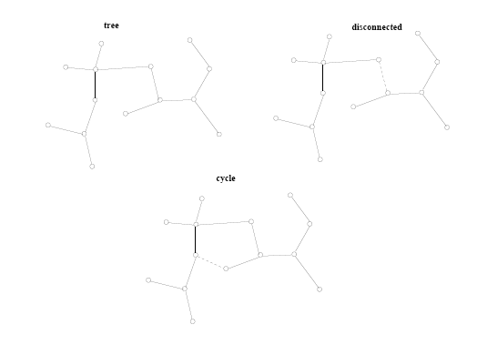
Terminology (cont’d)
A tree is a connected, acyclic undirected graph

Slide 24
Terminology
Connected – every pair of vertices is connected by a path
connected
A
B
F
D
E
C
G

Slide 25
Terminology
Connected (undirected graphs) – every pair of vertices is connected by a path
not connected
A
B
F
D
E
C
G

Slide 26
Terminology
Strongly connected (directed graphs) –
Every two vertices are reachable by a path
not strongly connected
A
B
F
D
E
C
G

Slide 27
Terminology
Strongly connected (directed graphs) –
Every two vertices are reachable by a path
not strongly connected
A
B
F
D
E
G

Slide 28
Terminology
Strongly connected (directed graphs) –
Every two vertices are reachable by a path
strongly connected
A
B
F
D
E
G

Slide 29
Different types of graphs
What is a tree (in our terminology)?
F
A
B
H
D
E
C
G

Slide 30
Different types of graphs
Tree – connected, undirected graph without any cycles
F
A
B
H
D
E
C
G

Slide 31
Different types of graphs
Tree – connected, undirected graph without any cycles
F
A
C
B
H
D
E
need to specify root
G

Slide 32
Different types of graphs
Tree – connected, undirected graph without any cycles
F
A
B
H
D
E
C
G

Slide 33
Different types of graphs
DAG – directed, acyclic graph
F
A
B
H
D
E
C
G

Slide 34
Different types of graphs
Complete graph – an edge exists between every node
A
F
B
D
C

Slide 35
Different types of graphs
Bipartite graph – a graph where every vertex can be partitioned into two sets X and Y such that all edges connect a vertex u ∈ X and a vertex v ∈ Y
A
E
B
F
C
G
D

Slide 36
When do we see graphs in real life problems?
Transportation networks (flights, roads, etc.)
Communication networks
Web
Social networks
Circuit design
Bayesian networks

Slide 37

Representing graphs

Slide 38
Representing graphs
Adjacency list – Each vertex u ∈ V contains an adjacency list of the set of vertices v such that there exists an edge (u,v) ∈ E
A:
B
D
A
B:
A
D
B
C:
D
D
E
D:
A
B
C
E
C
E:
D

Slide 39
Representing graphs
Adjacency list – Each vertex u ∈ V contains an adjacency list of the set of vertices v such that there exists an edge (u,v) ∈ E
A:
B
A
B:
B
C:
D
D
E
D:
A
B
C
E:
D

Slide 40
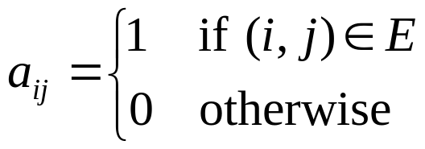
Representing graphs
Adjacency matrix – A |V|x|V| matrix A such that:
A B C D E
A 0 1 0 1 0
B 1 0 0 1 0
C 0 0 0 1 0
D 1 1 1 0 1
E 0 0 0 1 0
A
B
D
E
C

Slide 41
Representing graphs
Adjacency matrix – A |V|x|V| matrix A such that:
A B C D E
A 0 1 0 1 0
B 1 0 0 1 0
C 0 0 0 1 0
D 1 1 1 0 1
E 0 0 0 1 0
A
B
D
E
C

Slide 42
Representing graphs
Adjacency matrix – A |V|x|V| matrix A such that:
A B C D E
A 0 1 0 1 0
B 1 0 0 1 0
C 0 0 0 1 0
D 1 1 1 0 1
E 0 0 0 1 0
A
B
D
E
C

Slide 43
Representing graphs
Adjacency matrix – A |V|x|V| matrix A such that:
A B C D E
A 0 1 0 1 0
B 1 0 0 1 0
C 0 0 0 1 0
D 1 1 1 0 1
E 0 0 0 1 0
A
B
D
E
C

Slide 44
Representing graphs
Adjacency matrix – A |V|x|V| matrix A such that:
A B C D E
Is it always symmetric?
A 0 1 0 1 0
B 1 0 0 1 0
C 0 0 0 1 0
D 1 1 1 0 1
E 0 0 0 1 0
A
B
D
E
C

Slide 45
Representing graphs
Adjacency matrix – A |V|x|V| matrix A such that:
A B C D E
A 0 1 0 0 0
B 0 0 0 0 0
C 0 0 0 1 0
D 1 1 0 0 0
E 0 0 0 1 0
A
B
D
E
C

Slide 46
Properties of Adjacency-List Representation
Memory required
  Θ(V + E)
Preferred when
  The graph is sparse: ⎜E ⎜ << ⎜V ⎜²
  We need to quickly determine the nodes adjacent to a given node.
Disadvantage
  No quick way to determine whether there is an edge between node u and v
Time to determine if (u, v) ∈ E:
  O(degree(u))
Time to list all vertices adjacent to u:
  Θ(degree(u))
1
2
3
5
4
Undirected graph
1
2
3
4
Directed graph

Slide 47
Properties of Adjacency Matrix Representation
Memory required
  Θ(V²), independent on the number of edges in G
Preferred when
  The graph is dense: ⎜E ⎜is close to ⎜V ⎜²
  We need to quickly determine if there is
  an edge between two vertices
Time to determine if (u, v) ∈ E:
  Θ(1)
Disadvantage
  No quick way to determine the vertices
  adjacent to another vertex
Time to list all vertices adjacent to u:
  Θ(V)
1
2
3
5
4
Undirected graph
1
2
3
4
Directed graph

Slide 48
Adjacency list vs. adjacency matrix
Adjacency list
Adjacency matrix
Sparse graphs (e.g. web)
Space efficient
Must traverse the adjacency list to discover is an edge exists
Dense graphs
Constant time lookup to discover if an edge exists
Simple to implement
For non-weighted graphs, only requires boolean matrix
Can we get the best of both worlds?

Slide 49
Sparse adjacency matrix
Rather than using an adjacency list, use an adjacency hashtable
A:
hashtable [B,D]
A
B:
hashtable [A,D]
B
D
C:
hashtable [D]
E
D:
hashtable [A,B,C,E]
C
E:
hashtable [D]

Slide 50
Sparse adjacency matrix
Constant time lookup
Space efficient
Not good for dense graphs, why?
A:
hashtable [B,D]
A
B:
hashtable [A,D]
B
D
C:
hashtable [D]
E
D:
hashtable [A,B,C,E]
C
E:
hashtable [D]

Slide 51
Weighted graphs
Adjacency list
  store the weight as an additional field in the list
A:
B:8
D:3
A
8
3
B
D
13
2
E
10
C

Slide 52
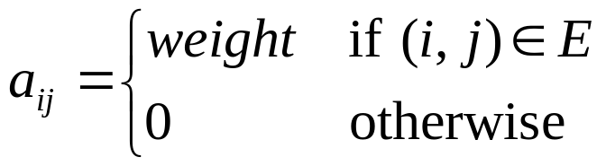
Weighted graphs
Adjacency matrix
A B C D E
A 0 8 0 3 0
B 8 0 0 2 0
C 0 0 0 10 0
D 3 2 10 0 13
E 0 0 0 13 0
A
8
3
B
D
13
2
E
10
C

Slide 53
Graph algorithms/questions
Graph traversal (BFS, DFS)
Shortest path from a to b
  unweighted
  weighted positive weights
  negative/positive weights
Minimum spanning trees
Are all nodes in the graph connected?
Is the graph bipartite?

Slide 54
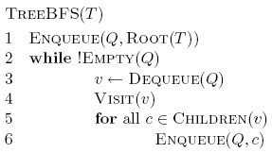
Breadth First Search (BFS) on Trees

Slide 55
Tree BFS
A
B
D
E
C
F
G
Q:

Slide 56
Tree BFS
A
B
D
E
C
F
G
Q: A

Slide 57
Tree BFS
A
B
D
E
C
F
G
Q:

Slide 58
Tree BFS
A
B
D
E
C
F
G
Q: B, D, E

Slide 59
Tree BFS
A
B
D
E
C
F
G
Q: D, E

Slide 60
Tree BFS
A
B
D
E
C
F
G
Q: D, E, C, F

Slide 61
Tree BFS
A
B
D
E
C
F
G
Q: E, C, F

Slide 62
Tree BFS
A
B
D
E
C
F
G
Q: E, C, F
Frontier: the set of vertices that have been visited so far

Slide 63
Tree BFS
A
B
D
E
C
F
G

Slide 64
Tree BFS
A
B
D
E
C
F
G

Slide 65
Tree BFS
A
B
D
E
C
F
G

Slide 66
Tree BFS
A
B
D
E
C
F
G

Slide 67
Tree BFS
What order does the algorithm traverse the nodes?
BFS traversal visits the nodes in increasing distance from the root

Slide 68
Tree BFS
Does it visit all of the nodes?

Slide 69
Running time of Tree BFS
Adjacency list
  How many times does it visit each vertex?
  How many times is each edge traversed?
  O(|V|+|E|)
Adjacency matrix
  For each vertex visited, how much work is done?
  O(|V|²)

